Slide 1




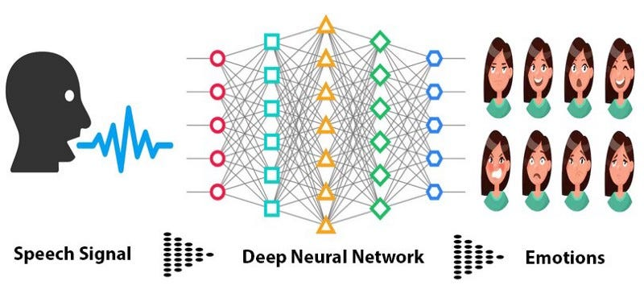
From Silence to Support: AI-Powered Solutions for Postpartum Depression
Dr. Zeynep Orhan, Mounika Prabha Mahadasu, Rakesh Sarma Karra, Meghana Kota, Sindhuja Rajidi
Advanced Data Analytics | Toulouse Graduate School | University of North Texas
Abstract
Introduction
Methods
Postpartum Depression (PD) is a serious mental health issue affecting 10-20% of mothers within a year of childbirth.
Symptoms like sadness, fear, and exhaustion impact both mother and child, affecting family relationships and child development. Many women go untreated due to stigma, lack of awareness, or the limitations of self-reporting tools like the Edinburgh Postnatal Depression Scale (EPDS).
AI is transforming how we detect and treat postpartum depression (PD). Traditional tools like the EPDS have limits, as mothers may not recognize or share their distress.
AI can analyze speech, emotions, and physical signs in real-time, allowing earlier and more accurate diagnosis. It also enables remote healthcare through telemedicine, making mental health support accessible, especially for women in rural areas. Organizations like PSI and NIMH are working to improve postpartum depression diagnosis and treatment using AI.
AI and ML are transforming PD treatment by analyzing large datasets to predict risk and detect early symptoms.
AI can identify emotional distress through speech patterns and hormone levels, creating personalized treatment plans.
Continuous monitoring tools like SER track emotional changes in real-time, helping doctors adjust treatments for better care and outcomes for mothers and babies.
Postpartum Depression (PD) affects 10-20% of new mothers globally.
PD symptoms impact both the mother and child, influencing family dynamics and child development.
Traditional methods for diagnosing PD, like the EPDS, have limitations.
AI can overcome these limitations by providing objective, real-time data.
AI analyses speech, emotional cues, and physiological indicators.
Speech Emotion Recognition (SER) detects emotional distress from voice patterns.
NLP analyses text data from interviews, social media, or clinical records for linguistic markers of PD.
Data from clinical trials, e-health records, and patient interviews are used to train AI models.
Applications of AI & ML in Diagnosis
Speech Emotion Recognition (SER) detects emotional distress in real-time.
Natural Language Processing (NLP) analyzes written and spoken text to identify PD risk factors.
AI-powered telemedicine platforms make mental health care accessible for women in rural and underserved areas.
Personalized treatment plans are created by AI based on patient data and symptom severity.
SER
Prevalence &
Treatment Gaps
Results
Conclusion and Future Work
AI technologies have shown promise in improving early diagnosis and treatment outcomes for PD.
Ongoing research continues to refine AI tools for broader use in clinical settings.
AI and ML are revolutionizing the diagnosis, treatment, and monitoring of postpartum depression.
Future work will focus on refining AI models for widespread use and scalability in clinical environments.
Contact
References
Fanos, V., et al. (2023). Postpartum depression screening through artificial intelligence: preliminary data through the Talking About algorithm. JPNIM.
Levis, B., et al. (2020). Accuracy of the Edinburgh Postnatal Depression Scale (EPDS). BMJ.
Pitt, B. (1968). “Atypical” Depression Following Childbirth. British Journal of Psychiatry.
Sindhuja Rajidi
sindhujarajidi@my.unt.edu
Student ID: 11668199

